Slide 1
501: The Employee Performance Review Process

Slide 2
Learning Objectives
Learning Objectives:
Participant will be able to:
Identify various types of employee performance reviews;
Describe the importance of defining agency expectations as they relate to the Employee Performance Review Process;
Identify the components of S.M.A.R.T. goals as they relate to the goal-setting process; and
Describe key concepts associated with preparing for, holding, and following up on an employee performance review meeting.

Slide 3
Competencies
501-5 The Supervisor is able to formulate and communicate performance expectations of supervisees in behavioral and measurable terms.
502-2 The Supervisor knows how staff members’ attitudes, needs, behaviors, personal preferences, and cultural backgrounds may influence perceptions and performance.
534-1 The Supervisor understands the role and function of the employee performance evaluation in the management of the organization.

Slide 4
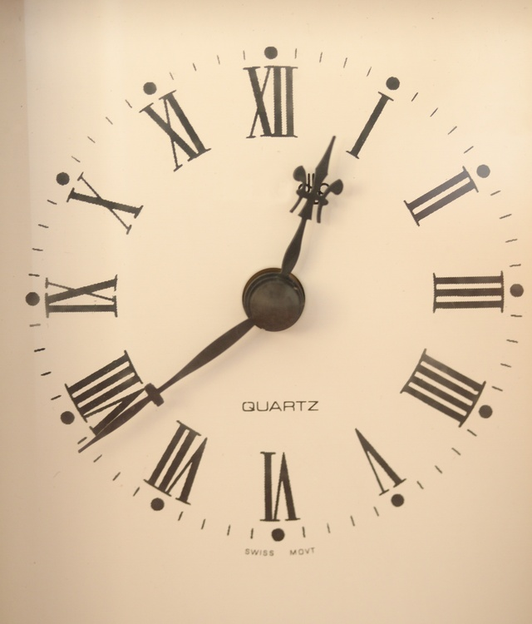
Agenda
Introduction and Workshop Overview
Types of Performance Evaluations
The Importance of Defining Agency Expectations and Standards
Establishing Performance Goals
Preparing for the Meeting
Holding the Meeting
Follow-Up
Summary and Evaluation

Slide 5
Types of Performance Evaluations
Probationary
Interim
Annual
Semi-annual

Slide 6
Agency Expectations
Mission
Vision
Values
Performance
Core
Goals and Objectives

Slide 7
Collaborative Goal Setting
More likely to get employee buy-in;
Place more responsibility for the process on the employee;
Takes the burden off of the manager/supervisor;
There are fewer surprises for the manager/supervisor and employee during the rating period;
Goals may be more realistic; and
Demonstrates to employee that manager/supervisor has confidence in them.

Slide 8
Non-Collaborative Goal Setting
Manager/supervisor maintains complete control;
Faster than collaborative goal setting;
Easier for the manager/supervisor; and
Manager/supervisor gains better knowledge of employee’s job.

Slide 9
S.M.A.R.T System
Goals should be:
Specific
Measurable
Action-oriented
Realistic
Time-bound

Slide 10
Steps in the Employee Performance Review Process
Preparation for the meeting
The meeting
Action planning
Follow-up

Slide 11
Preparing the Employee for the Review
Explain the purpose of the Employee Performance Review Process;
Help the employee recognize the importance of continually growing as a professional;
Explain the flow of the process; and
Help the employee connect with the agency’s mission, vision, and values.

Slide 12
Preparing the Employee for the Review (cont’d)
Ask the employee to come to the review having considered:
Where they are currently as a professional;
Where they would like to see themselves;
What they are currently doing or what is currently in place that is helping them to achieve their desired future state;
What barriers are in place that keep them from achieving their desired future state; and
What they need in the future to help them achieve their desired future state.

Slide 13
Preparing the Employee for the Review (cont’d)
Consider providing the employee with a blank EPR form and ask them to complete it prior to the meeting.
Ask the employee to review their job description prior to the EPR meeting.

Slide 14
Preparing Yourself for the Employee Performance Review Meeting
Know and “own” your agency’s mission, vision, and values.
Consider how you will get your employee invested in the mission, vision, and values of your agency.
What will the employee identify with the most?
What is the hook that will motivate the employee?
Take into account cultural and other
considerations.

Slide 15
Measuring Performance
Completing the EPR form:
Collect data;
Review notes from the rating period;
Review measures to see if employee reached or surpassed goals set for rating period;
Focus on behaviors not attitudes;
Consider the impact of performance on the agency; and
Prepare thoroughly for the discussion of goals with your employees.

Slide 16
Measuring Performance cont’d.
Measurement tool should be fair;
Compare data collected during rating period to see if goals are being reached;
Use and share data gathered quickly; and
Determine what impact employee performance is having on the agency.

Slide 17
Common Performance Review Pitfalls
Halo Effect
Devil Effect
Comparison
First Impression
Recency Effect
Like Me Effect
Central Tendency

Slide 18
Conducting the Performance Review Meeting
Revisit any outstanding items/issues:
Reiterate the purpose and flow of the process;
Help the employee recognize the importance of continually growing as a professional; and
Help the employee connect with the agency’s mission, vision, and values.
Ask the employee to share the things that they were asked to consider in preparation for the meeting (e.g., their completed version of the EPR form, where they are currently as a professional, where they would like to see themselves, etc.).

Slide 19
Conducting the Performance Review Meeting (cont’d)
Review your completed version of the EPR form with the employee and share the goals that you have identified for the employee.
Compare notes and solidify goals and next steps.

Slide 20
Potential Responses to Identified Goals
Rejection
Acceptance
Commitment
Buy-in

Slide 21
The Supervisor’s/Manager’s Role in the Meeting
Act as a mentor/coach
Act as facilitator
Eliminate blame
Provide recognition
Remain objective
Be enthusiastic
Be supportive
Be trusting & trustworthy
Remain focused
Be goal-oriented
Be knowledgeable
Be observant
Be respectful
Remain patient
Be clear
Be assertive

Slide 22
Small Group Activity
Review and discuss the background information regarding the employee.
Develop a Performance Plan based on the evaluation. Record Performance Plan on flip chart paper.
Explore possible approaches to presenting the Performance Plan to the employee.
Consider how the employee may respond to the Performance Plan and, as a result, the possible responses the supervisor might consider.

Slide 23
Pre-work Review
Do the developed goals meet the S.M.A.R.T. criteria?
How do participants’ ways of presenting the plan to Ernest and Ernest’s potential responses fit with what was presented in this workshop?
How would participants change their answers now that they have completed this training?

Slide 24
Follow-Up
Base follow-up and monitoring on the established performance standards and performance goals;
The monitoring process should be a problem-solving process;
Provide recognition;
Regularly check in with employees regarding actions and steps taken and developed at the previous employee performance review meeting; and
Collect data and give immediate feedback.

Slide 25
The Benefits of Immediate Feedback
Clarifies expectations;
Demonstrates they care about their employees achieving success on the job;
Opens the door for the manager/supervisor to receive feedback; and
Clears the air.

Slide 26
Questions and Answers

